Slide 1

W E L C O M E
H.A.C.A.
ANNUAL GENERAL MEETING (AGM)
28th June 2025

Slide 2
H.A.C.A.
YEAR
OVERVIEW
(Apr. 2024 – Mar. 2025)

Slide 3
H.A.C.A. YEAR OVERVIEW
(Apr. 2024 – Mar. 2025)
Governance
Finance 1
Finance 2
Funding & Grants
Key Activities, Events & Projects (HACA)
Key Activities, Events & Projects (Others 1 & 2)
Some Annual National Events Marked
Member & Community Services
Building Maintenance
Research, Surveys & Consultations
Pressure Points
Miscellaneous

Slide 4
GOVERNANCE
(Apr. 2024 – Mar. 2025)
Strengthened Board – Full Capacity (9)
Strengthened Reconciliation Committee (5)
Policies – Reviews, Updates & New (Acceptable Behaviour)
Change Legal Status of HACA Charity (e.g. CIO)
Review Constitution
Gas Reconnection Planning
Strategic Plan & Business Plan Commissioning
Meetings – Annual, Board, General
HEYCF Leadership Advocacy Network
Community Centres Regular Network Meetings
Community Asset Transfers (CAT) Meetings/Training
Things To Do……
Refresh/Develop Strategic Plan
Refresh/Develop Business Plan

Slide 5
HACA FINANCE (1)
(Apr. 2024 – Mar. 2025)
Accounts 2023-2024 - Timely Submission to Charity Comm.
Debt Free Status – Maintained
Income Sources:
- Room Hire (Offices, Dedicated Spaces, / Events)
- Membership Fees
- Admin. Grant
- Utilities Rebate (50%)
Headline Figures 2024-2025 – Treasurer To Do
HACA Contactless: SumUp & Paypal
Org. Participation Fees (HEYCF & Smile Foundation)

Slide 6
HACA FINANCE (2)
(Apr. 2024 – Mar. 2025)
MONTHLY BILLS
Electric £700
Gas £300
Water £70
Waste & Recycle £100
Telephone & Internet £80
Mobile £20
ANNUAL BILLS
Premises Licence £180
Business Rates £450
Fareshare Food Supplies £1,100
OTHER
Wed Drop-In Cooking - £200 pm (per month)
HACA Stock £160 pm (Food Ingredients, Toiletries, Cleaning/Hygiene)

Slide 7
FUNDING & GRANTS
(Apr. 2024 – Mar. 2025)
SUCCESSFUL
HACA Unveiled (Apr 2024)
Smile Foundation National GSP Extension (GSP 2) (Apr 2024)
KHCC Healthy Holidays (Summer) (May 2024)
Hull CVS Decoration Funding (Jun 2024)
National Highways (In Kind) – Double Glazing (x3 small windows on 1st floor) (Jul 2024)
Barclays Community Football Fund (Oct 2024)
Two Ridings Hull Community Fund 2024 (Oct 2024)
UNSUCCESSFUL
Lloyds Bank Racial Equity Programme 2024

Slide 8
HACA: KEY ACTIVITIES, EVENTS & PROJECT
(Apr. 2024 – Mar. 2025)
Slavery Remembrance Day
Black History Month (Janet Alder Book Launch, Schools Sessions, Finale (with Football Champions Presentation & Dialogue with BBC Sheffield Presenter)
Refugee Week Celebrations (Interactive Social)
Weekly Free Food Bags
Weekly Wed. Drop-In
Money Matters - Household Support Fund (HSF) 5
Cultural Connect Pilot (Delivered in 3 Schools)
Communities EM-Brace (HACA & Age UK)
VIPER (HACA & West Yorkshire Police)
HACA Gen2 – GSP 2 Outdoor Activities
HACA Students Social 4

Slide 9
OTHER 1: KEY ACTIVITIES, EVENTS & PROJECT
(Apr. 2024 – Mar. 2025)
Freedom Festival 2024 – Launch Event
Stephen Lawrence Reflection Day (+ PC Danny Fleming Farewell )
Stand Up To Racism Events
Hull International Carnival Event
HANA Fashion Show
International Women's Day (research conversation with Ethiopian women – Women Accede & HACA)
Sickle Cell Awareness Presentation
HANA Football Tournament
Forum@PQ – Launch Event
Hull Bahia Group - Building Vibrant Communities Conference

Slide 10
OTHER 2: KEY ACTIVITIES, EVENTS & PROJECT
(Apr. 2024 – Mar. 2025)
History of Community Centres in Hull - Hull's Comm. Centre Heritage
Riots & Community Safety // KHCC Community Shield
Community Leaders Unite: Standing in Solidarity: Stand Against Extremist Violence
Lest We Forget Calendar 2025: The African Caribbean Contribution to Wartime Britain
Empire and Allied Women in WW1 & WW2. Black History Month Presentation Oct-Dec 2024
One City, One Beat, Hull film shoot
Little Amal Event at Hull East Park

Slide 11
SOME ANNUAL NATIONAL EVENTS MARKED
(Apr. 2024 – Mar. 2025)
Africa Day (May)
International Anti-Racism Day (Mar)
International Women’s Day / Women’s Week (Mar)
Mental Health Awareness Week (May)
Trustee Week (Nov)
Volunteer Week (Jun)
Windrush Day (Jun)
World Earth Day (Apr)

Slide 12
MEMBERS & COMMUNITY SERVICES
(Apr. 2024 – Mar. 2025)
HACA Hardship Fund
HACA Fri. Free Food Bags Project (Weekly)
HACA Wed. Drop-In (Weekly)
HACA Giveaways (Monthly)
Christmas Love Bags (Annual)
HACA Refugee Week Gifts (Annual)
Member Hospitality (Ad Hoc)
HACA Gen2 Socials (partly underwritten)
Signposting & Some Advice
References, Letters of Support, & Elders Support
Free DBS Checks
Free Training (Food Safety, Safeguarding, First Aid etc.)
Free Tickets (Football, Theatre, Ice Skating)
Free Personal Publicity (Events, Requests Other Notifications)

Slide 13
BUILDING MAINTENANCE (In & Out)
(Apr. 2024 – Mar. 2025)
HACA Community Clean-Up – 3 days
Gas Supply Reconnection – Planning underway
Kitchen – Challenging with all users (Clients, Members, Guests) – Environment Health Visit
Garden 1 – HACA Asset // Problem with Cars Parking
– Balfour Beatty & HACA Collaboration (Cleaned HACA’s 2nd Back Garden)
Building Security – Robust Coded Combination Lock
Frontage & Red Door – Needs Painting
KHCC – Regular Servicing
- But Slow Response on Reported Maintenance (Toilets)

Slide 14
RESEARCH, SURVEYS & CONSULTATIONS
(Apr. 2024 – Mar. 2025)
HACA Community Cohesion Symposium (Hull Riots)
Hull and East Yorkshire (HEY) Devolution Public Consultation
Survey - Hull’s Big Mental Health Conversation
EMRI Research
Community Leaders Symposium about Climate Change Impacts in Hull
VCSE Barometer Survey
Petitions/Protests (Change, Care4Calais, Megaphone)

Slide 15
PRESSURE POINTS
(Apr. 2024 – Mar. 2025)
More Trustees and Volunteers
Middle Management Layer
Increased Centre Opening Days/Times
Volunteer Cleaners
Social Media & Publicity Volunteer
Increased Footfall and Membership
Need Salaried Positions (e.g. Centre Manager, Facilities Manager)

Slide 16
MISCELLANEOUS
(Apr. 2024 – Mar. 2025)
New HACA Website
New HACA HP Laptop (nicknamed Lincoln)
New Projector – Donated by KCOM
BBC Radio Humberside – HACA/Bongi on the Fiona Mills early morning programme
MEARs Hull Info. Pack (Refugees)– HACA Included
HACA Kitchen Registration Planning (FSA & Enviro. Health)
Sourcing Additional Food Supplier
PENDING
Hull Independent Cinema - A Story of Bones – To Show at HACA Centre
Street Team Productions & HACA- Possible Collaboration

Slide 17
SUMMARY
(Apr. 2024 – Mar. 2025)
Again, We Have Covered Some Distance!!
Well-Done, Everyone!
We’re Still On The Right Path,
And Making Good Progress...
WE KEEP MOVING….

Slide 18
FINAL THOUGHTS
(Apr. 2024 – Mar. 2025)
I Charge Us All To:-
Continue The Good Work
Watch Out And Care For Each Other
Support, and Work With, Your Board
Serve Well, Develop & Cultivate Good Relationships
Be Selfless, Sacrificial & Outward Thinking
Preserve Our Roots & Heritage
Cultivate A Legacy For Those To Come After Us
Let Us Make Our Contribution Count
THANK YOU FOR LISTENING
Angela Murden – 20/4/2024

Slide 19
H.A.C.A.
FINANCE

Slide 20
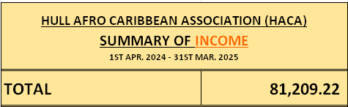
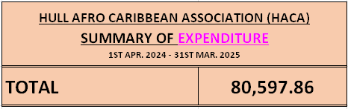
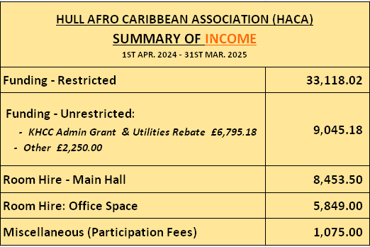
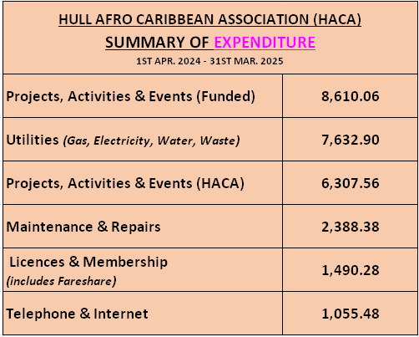
FINANCE: PROVISIONAL HEADLINE FIGURES
(Apr. 2024 – Mar. 2025)

Slide 21
VOLUNTEER CALLOUT
(Apr. 2024 – Mar. 2025)
Your Charity Needs You
Volunteer for:
SOCIAL MEDIA & WEBSITE & PUBLICITY
CLEANING
FOOD COLLECTION (Driver with Car)
CENTER HANDYMAN JOBS
ATTENDING MEETINGS FOR HACA
HACA NEWSLETTERS
GARDEN & OUTDOORS MANAGEMENT
FOOTBALL PLAYER, REFEREE, MANAGER

Slide 22
PUBLICITY
(Apr. 2024 – Mar. 2025)
UPCOMING EVENTS
HACA Shenanigans (Summer) 2025 (Healthy Holidays) (Aug)
Slavery Remembrance Day (Aug)
Black History Month (Oct)
….And More – So Stay Tuned…..
Round The Firepit
Dancing – Zumba, Salsa
Film Nights
Fun Exercise & Fitness Classes
Walking & Wandering Days
HACA Vocals

