Slide 1

W E L C O M E
H.A.C.A.
ANNUAL GENERAL MEETING (AGM)
20th April 2024

Slide 2
H.A.C.A.
YEAR
OVERVIEW
(Apr. 2023 – Mar. 2024)

Slide 3
H.A.C.A. YEAR OVERVIEW
(Apr. 2023 – Mar. 2024)
Governance
Finance
Funding & Grants
Key HACA Activities, Events & Projects
Some Annual National Events Marked
Member & Community Services
Some Partners (Supporting & Supported)
Building Maintenance (In and Out)
Supporting Others
Research, Surveys & Consultations
Pressure Points
Miscellaneous

Slide 4
GOVERNANCE
(Apr. 2023 – Mar. 2024)
Strengthened Board – New Trustee (AO)
Board Working Together Well
Lease – Finally Sorted (thanks to our Solicitor!)
Policies – Reviews, Updates & New Ones
Trustee Network Member (Hosts - Smile Foundation & Rollits)
Continued IT Upgrade (New Desktops, Monitors, TV Screens, IT Accessories)
Things To Do……
Review Constitution
Develop Strategic Plan
Change Legal Status of HACA Charity (e.g. CIO, Limited by Guarantee)

Slide 5
HACA FINANCE
(Apr. 2023 – Mar. 2024)
Accounts 2022-2023 – Timely Submission to CC
Income Sources:
- Room Hire
    - Membership Fees
    - Admin. Grant
    - Utilities Rebate (50%)
Debt Free Status - Maintained
2022-2023 Deep Dive – Treasurer To Do
2023-2024 Headline Figures – Treasurer To Do

Slide 6
FUNDING & GRANTS
(Apr. 2023 – Mar. 2024)
4 Successful
    GSP1, Communities Em-Brace (Community Companions), Heritage Fund, GSP2
5 Submitted & Pending
    Fire Service, CVS Decoration Fund, Health Holidays, KCOM Community Grant, CVS Capital Grant Fund
2 In Development
    NH Social Value, Lloyds Racial Equity, Digital Inclusion
1 In Kind
    National Highways
6 Unsuccessful
    Affordable Warmth, National Lottery, KYN One-Vessel, UKSPF People & Skills, Youth Investment Fund

Slide 7
KEY HACA ACTIVITIES, EVENTS & PROJECT
(Apr. 2023 – Mar. 2024)
HACA Slavery Remembrance Day (Aug)
HACA Black History Month (Oct)
HACA Refugee Week Celebrations (Jun)
HACA Leeds Carnival Trip (Aug)
HACA Christmas Party (Dec)
HACA Volunteer Awards (Jul)

Slide 8
SOME ANNUAL NATIONAL EVENTS MARKED
(Apr. 2023 – Mar. 2024)
International Women’s Day / Women’s Week ( Mar)
Volunteer Week (Jun)
Windrush Day (Jun)
Mental Health Awareness Week (May)
Trustee Week (Nov)
International Ani Racism Day (Mar)
Africa Day (May)
World Earth Day (Apr)
We Will Start Marking Caribbean Community Day (1/7/2024)

Slide 9
KEY MEMBERS & COMMUNITY SERVICES
(Apr. 2023 – Mar. 2024)
HACA Wed. Drop-In (Weekly)
HACA Fri. Free Food Bags Project (Weekly)
HACA Giveaways (Monthly)
HACA Refugee Week Gifts (Annual)
Christmas Love Bags (Annual)
References & Letters of Support
HACA Gen2 Socials (partly underwritten)
Free Training (e. g. L2 Food Safety, Safeguarding etc.)
Free DBS Checks

Slide 10
SOME PARTNERS (a)
(Supporting & Supported)
(Apr. 2023 – Mar. 2024)
Smile Foundation - GSP Projects; Trustee Network
KCOM - IT equipment; Football Tickets
Open Doors - Refugee Week
Stand Up To Racism - Petitions; Protests
Fareshare - Food Supplies, Food Surpluses, Freezer
Yoruba Community - Support Our Activities & Events

Slide 11
SOME PARTNERS (b)
(Supporting & Supported)
(Apr. 2023 – Mar. 2024)
Hull Carnival Arts
  Carnival Costumes; Parade Events
Age UK
  Communities Em-Brace – Older People Drop-In
Carnegie Library
  History Recording of Hull Community Centres
Hull City Council
  Community Strategy; Money Matters Initiative (£90)

Slide 12
SOME PARTNERS (c)
(Supporting & Supported)
(Apr. 2023 – Mar. 2024)
Hull CVS
  Charity & Sector Support; VCSE Assembly; Time2Volunteer; Festival of Volunteering, Community Centre Network; Volunteer Managers & Co-ordinators Meetings etc.
HEY Confident Futures
  Leadership Advocacy Network; Partnership Bids; Professional Self-Care
Humberside Police
  Hull IAG Meetings; Hate Crime; TPR

Slide 13
BUILDING MAINTENANCE (In & Out)
(Apr. 2023 – Mar. 2024)
Gas – Re-instate Supply
Kitchen – Cleaning; Locking; Upgrading
Garden – Restore to Former Glory
Building Security – Robust Coded Combination Lock
KHCC – Decoration Fund; Front Painting
KHCC – Regular Servicing; Guttering; Toilets

Slide 14
SUPPORTING OTHERS (a)
(Apr. 2023 – Mar. 2024)
Christopher Alder – 25yrs Anniversary
  Justice for Christopher Alder Campaign; Supporting Janet Alder (Hosted by HACA and Stand Up To Racism)
Stephen Lawrence Day
  Reflection Day
Hull University
  Fresher’s Week; Volunteer Fair
Plaque Commemoration in Filey
  Remembering and Celebrating WWII Afro Caribbean Servicemen who died in service.

Slide 15
SUPPORTING OTHERS (b)
(Apr. 2023 – Mar. 2024)
Sierra Leone Independence Day Celebrations
  Homecoming Exhibition at HACA
Leeds African Communities
  David Oluwale (DOMA), Hibiscus Rising
HANA Football World Cup
  Supporting the annual football match with the HACA Football Team
EMRI Conference - Leeds
  Participant at the World Café with a HACA Stall

Slide 16
RESEARCH, SURVEYS & CONSULTATIONS
(Apr. 2023 – Mar. 2024)
Signed a Joint Public Letter – Re Move-on Period Causing Homelessness
Youth Investment Fund 2: Evaluation Survey
VCSE Barometer Survey (Wave 4)
NHS App Community training survey
EMRI Research
Petitions/Protests – Change, Care4Calais, Megaphone

Slide 17
RESSURE POINTS
(Apr. 2023 – Mar. 2024)
Need Salaried Positions (e.g. Centre Manager, Facilities Manager)
Efficient Heating - Gas
More Trustees and Volunteers
Increased Centre Opening Days/Times
Increased Footfall and Membership
Middle Management Layer

Slide 18
MISCELLANEOUS
(Apr. 2023 – Mar. 2024)
HACA Website – Domain, Hosting, Pilot
Kitchen Registration – FSA & Enviro. Health
Sourcing Additional Food Supplier
History Recording
More Chairs

Slide 19
SUMMARY
(Apr. 2023 – Mar. 2024)
We Have Really Covered Some Distance!!
Well-Done, Everyone!
We Are On The Right Path,
And Making Good Progress.
LET’S KEEP GOING….

Slide 20
FINAL THOUGHTS
(Apr. 2023 – Mar. 2024)
I Charge Us All To:-
Continue The Good Work
Watch Out And Care For Each Other
Support, and Work With, Your Board
Serve Well, Develop & Cultivate Good Relationships
Be Selfless, Sacrificial & Outward Thinking
Preserve Our Roots & Heritage
Cultivate A Legacy For Those To Come After Us
Let Us Make Our Contribution Count
THANK YOU FOR LISTENING
Angela Murden – 20/4/2024

Slide 21
H.A.C.A.
FINANCE

Slide 22
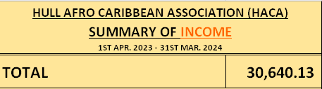
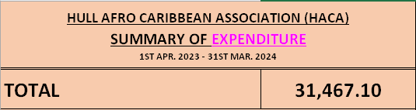
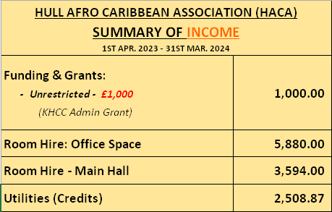
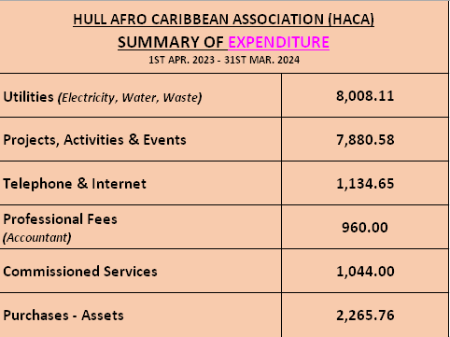
FINANCE: PROVISIONAL HEADLINE FIGURES
(Apr. 2023 – Mar. 2024)

Slide 23
VOLUNTEER CALLOUT
(Apr. 2023 – Mar. 2024)
Your Charity Needs You to Volunteer for:
  NEWSLETTERS CO-ORDINATOR
  SOCIAL MEDIA CO-ORDINATOR
  CATERING & HOSPITALITY CO-ORDINATOR
  CLEANING CO-ORDINATOR
  CENTER FACILITIES CO-ORDINATOR
  OUTDOORS CO-ORDINATOR
  FOOTBALL CO-ORDINATOR
  RESEARCH CHAMPIONS

Slide 24
PUBLICITY (a)
(Apr. 2023 – Mar. 2024)
UPCOMING EVENTS
Stephen Lawrence – Reflection Day – 22nd Apr.
Healthy Holidays (Aug)
HACA Social – Monthly
Activities & Events Team – No Updates
General Meeting (Strategy Development) - TBC

Slide 25
PUBLICITY (b)
(Apr. 2023 – Mar. 2024)
REMINDERS
HACA Membership Renewals
Level 2 Food Safety Training (Text HACA Admin)
Free DBS Checks (Text HACA Admin)

Slide 26
PUBLICITY (c)
(Apr. 2023 – Mar. 2024)
TO COME…….
Film Nights
Fun Exercise & Fitness Classes
Round The Firepit
Dancing – Zumba, Salsa
Cuisine Challenge
HACA Vocals
Walking & Wandering Days
Reggae Nights
Group Outings & Link-Ups (locally & wider)
Visits & Link-Ups – Other Afro Caribbean Centres

